Slide 1
NEW JERSEY
PAID FAMILY & MEDICAL LEAVE
WHAT YOU NEED TO KNOW
Notes:
Rebecca

Slide 2
LEGAL DISCLAIMER
This presentation provides general information, not legal opinion.
The NJ Register and the NJ Administrative Code remain the official sources for regulatory information published by the NJDOL.

Slide 3
NOW MORE THAN EVER, WE NEED TIME TO GIVE AND RECEIVE CARE
The U.S. is the only advanced economy without a national paid family and medical leave policy – NJ is one of few states that has one!
NJ Paid Family and Medical Leave supports our health and the health of our families while advancing economic security, productivity at work, and gender equality.
Notes:
Rebecca

Slide 4
NJ PAID FAMILY & MEDICAL LEAVE:
NJ TEMPORARY DISABILITY INSURANCE (TDI)
NJ FAMILY LEAVE INSURANCE (FLI)
STATE AND FEDERAL JOB PROTECTION LAWS
Notes:
Rebecca

Slide 5
NJ TEMPORARY DISABILITY & FAMILY LEAVE INSURANCE
Cash benefits for when you have to stop working to:
Care for your own or a loved one’s physical or mental health
Care for yourself during pregnancy or childbirth recovery
Bond with a new child
Cope with domestic or sexual violence

Slide 6
EMPLOYER REQUIREMENTS
NJ employers are required to participate in these programs or provide employees coverage through a private insurance plan
• The federal government is exempt
• Temporary Disability is optional for local governments, for example, counties, municipalities, and school districts
If your employer is covered, they are required to set up payroll contributions for you. If you believe you are covered under the program but payroll contributions have not been made, you are still encouraged to apply as it may have been an error.
Notes:
Rebecca

Slide 7
EMPLOYER REQUIREMENTS
Display Temporary Disability and Family Leave Insurance posters in a workplace location clearly visible to employees
Provide written notice of Temporary Disability and Family Leave Insurance when an employee is hired, requests information, or notifies an employer of their need for leave
Report employee quarterly earnings to the state
No employer portion of the application
Notes:
Rebecca

Slide 8
EMPLOYEE ELIGIBILITY REQUIREMENTS
Earnings must be with covered employer(s)
Must meet earnings requirements; see myleavebenefits.nj.gov for the current year’s requirements
Generally, employees working substantially outside of NJ are not covered; still encouraged to apply
Valid Social Security Number required in application
Meet definition of an employee; properly classified independent contractors are not eligible. Learn more about worker misclassification at myworkrights.nj.gov

Slide 9
BENEFITS YOU CAN RECEIVE
85% of average weekly wages, up to a maximum
See myleavebenefits.nj.gov for the current year’s max benefit level
For Temporary Disability Insurance: up to 26 weeks of benefits, as certified by a medical professional​
For Family Leave Insurance: up to 12 weeks of benefits if taken consecutively, 56 days of benefits if taken intermittently; medical certification required for caregiving claims​

Slide 10
HOW ARE THE PROGRAMS FUNDED?
Temporary Disability Insurance: both employers and employees contribute to the cost of the program. Workers contribute through deductions taken out of their paychecks.
Family Leave Insurance: program is financed 100% by worker payroll deductions. Employers do not contribute to the program.
Notes:
Rebecca

Slide 11
QUALIFYING REASONS FOR NJ PAID FAMILY & MEDICAL LEAVE BENEFITS
Let’s review the scenarios for which you may receive Temporary Disability or Family Leave benefits.

Slide 12
CARING FOR YOURSELF: TEMPORARY DISABILITY INSURANCE
• If you cannot work due to a physical or mental health condition, including pregnancy/childbirth recovery and COVID-19
• May receive up to 26 weeks of benefits, as certified by a medical professional
Notes:
Rebecca

Slide 13
CARING FOR A LOVED ONE:
FAMILY LEAVE INSURANCE​
If you cannot work because you are:
Caring for a loved one with a physical or mental health condition
Coping with domestic or sexual violence or caring for a loved one who is a victim/survivor of domestic or sexual violence
Duration:
Up to 12 weeks of benefits if taken consecutively
56 days (8 weeks) of benefits if taken intermittently
Notes:
Rebecca

Slide 14
CARING FOR A LOVED ONE:
FAMILY LEAVE INSURANCE (CONTINUED)
Who is considered a “Family Member” in the law?
• Child (biological, adopted, foster, stepchild),
• Spouse (includes domestic partner and civil union partner)
• Parents
• Siblings
• Grandparents
• Grandchildren​
• In-laws
• Any blood-relation to the claimant
• Chosen family
• Any other individual with a close association equivalent of a family relationship
Notes:
Rebecca

Slide 15
BENEFITS FOR NEW PARENTS: TEMPORARY DISABILITY & FAMILY LEAVE INSURANCE
Typical benefits for a birthing parent without complications:
4 weeks for pregnancy
+ 6/8 weeks for recovery
+ 12 weeks for bonding (56 intermittent days)
= up to 24 weeks total
Notes:
Rebecca

Slide 16
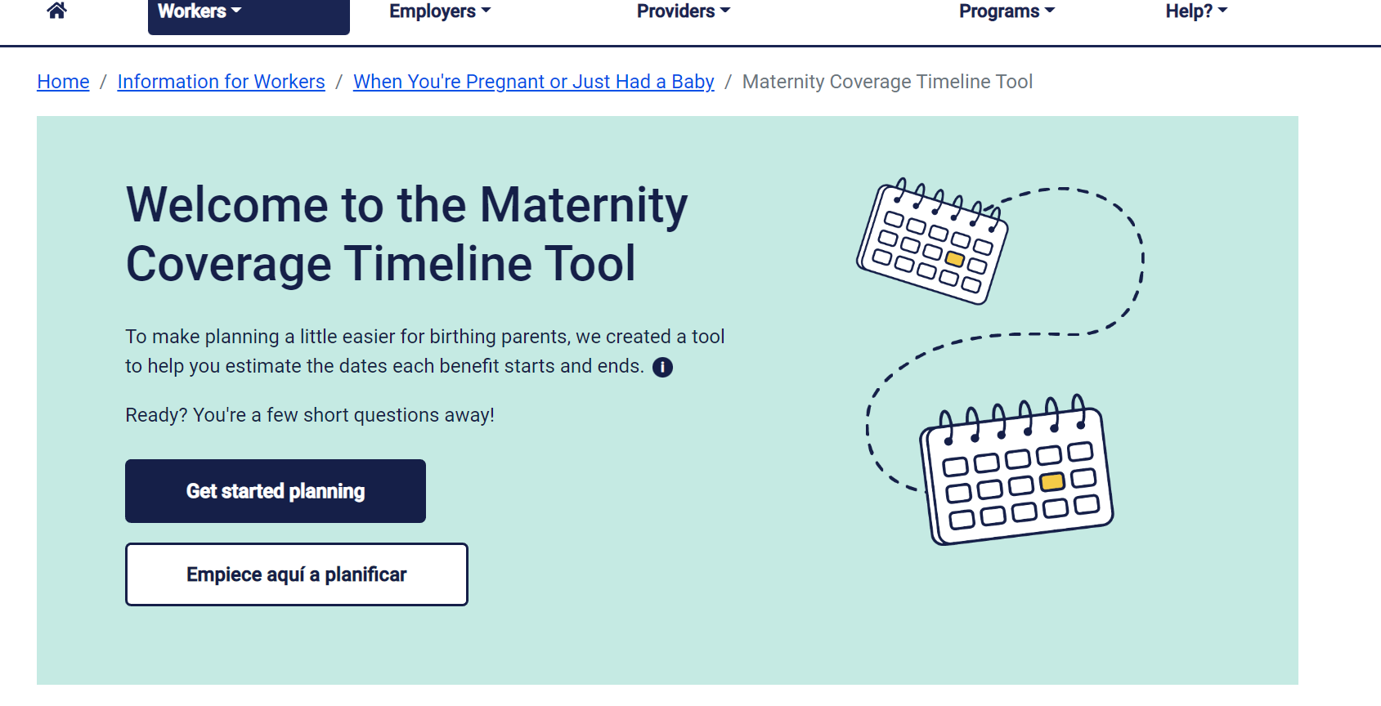
Maternity Timeline Tool
myleavebenefits.nj.gov/timeline
Notes:
Rebecca

Slide 17
BONDING WITH A NEW CHILD:
FAMILY LEAVE INSURANCE
Both parents can receive Family Leave benefits to bond with a child within a year of the child’s birth, adoption, or foster placement​.
Up to 12 weeks of benefits if taken consecutively, 56 days of benefits if taken intermittently.
Notes:
Rebecca

Slide 18
COPING WITH DOMESTIC OR
SEXUAL VIOLENCE: FAMILY LEAVE OR TEMPORARY DISABILITY INSURANCE
You can apply for Family Leave benefits to cope with domestic or sexual violence such as:
Seeking medical attention, therapy, victim advocacy, or legal services​
Safety planning or escaping abuse, such as staying in a domestic violence shelter​
Attending or preparing for court​
Recovering at home
You could also receive Temporary Disability benefits for related physical or mental health conditions, as certified by a medical provider.
Notes:
Rebecca

Slide 19
TRANSITIONING BETWEEN UNEMPLOYMENT AND TEMPORARY DISABILITY/FAMILY LEAVE
Unemployed? You can transition from unemployment benefits to paid family and medical leave benefits. Learn more: myleavebenefits.nj.gov/unemployed.
Laid off while receiving pregnancy/recovery or bonding benefits? You can apply for unemployment or reopen your claim. See myunemployment.nj.gov.
Notes:
Rebecca

Slide 20
Injured at Work?
Temporary Disability vs. Workers’ Compensation Benefits
Temporary Disability benefits cover non work-related illness or injuries. Workers’ Compensation benefits cover work-related illness or injury. Your employer’s Workers’ Compensation Insurance carrier determines if you are eligible to receive Workers’ Compensation benefits. Notify them immediately if you are injured on the job.
If they determine you are ineligible, you can file a claim to contest the decision with NJ Division on Workers’ Compensation. Learn more at nj.gov/labor/wc.
While your appeal is pending, you may qualify for Temporary Disability Insurance benefits.
If you're awarded workers compensation benefits, any Temporary Disability benefits you received must be returned to the State of NJ. The funds are typically returned by the worker’s compensation insurance carrier on your behalf.
Notes:
Rebecca

Slide 21
FAMILY LEAVE FOR PART-TIME EMPLOYEES
Employees with multiple jobs may receive Family Leave benefits if they only take leave from one employer, provided that they do not exceed their usual work schedule in their other job.
Employees with multiple jobs may receive Family Leave benefits if they take leave from more than one employer.
Benefit rate will be based on the wages from the employment from which they are taking leave.
Notes:
Rebecca

Slide 22
PAID TIME OFF PRIOR TO RECEIVING BENEFITS
Prior to Temporary Disability Insurance
Employers can require employees to utilize paid time off before receiving TDI. However, employers cannot require employees to utilize their NJ Earned Sick Leave.
Prior to Family Leave Insurance
Employees cannot require employees to utilize accrued paid time off before receiving FLI. However, employees may choose to, and it would not reduce the maximum duration of benefits to which the employee is entitled.

Slide 23
NOTIFYING YOUR EMPLOYER
Temporary Disability Insurance
the law does not specify how far in advance you must notify your employer
Family Leave Insurance
Bonding with a new child:
for continuous leave, you must notify your employer 30 days in advance of the date you plan to start your leave
for intermittent leave, you must notify your employer 15 days in advance of each anticipated absence
Caregiving for a loved one:
you must give your employer reasonable and practicable notice unless there are unforeseen or emergency circumstances
We encourage you to keep your employer informed. Having an open discussion with your employer about your need for leave will allow them to prepare for your absence and make adjustments to work schedules if necessary. Your employer may also be able to provide insight on job protection.
Notes:
Rebecca

Slide 24
TIPS ON APPLYING
Recommend applying online—but you can also apply by mail or fax
A trusted person can help you apply
For Temporary Disability, you can list a representative on your application, giving them permission to get information on your claim
Plan ahead to the best of your ability – it can take two to six weeks to approve a claim and pay benefits, once we have a complete application
Follow up with your medical provider
See myleavebenefits.nj.gov/your payment for payment information
Questions? Use our “Contact Us” form at myleavebenefits.nj.gov/email.
Notes:
Rebecca

Slide 25
JOB PROTECTION
Temporary Disability and Family Leave Insurance are partial wage replacement programs and they do not provide job protection.
However, during the period in which an employee receives TDI or FLI benefits, an employee’s job may be protected under federal or state laws.
Please note, you may be eligible for Temporary Disability or Family Leave Insurance benefits whether or not your job is protected under one of these laws.
Notes:
Rebecca

Slide 26
JOB PROTECTION​
Your job may be protected under the following laws:
Federal Family and Medical Leave Act (FMLA, 50+ employees)
Enforced by US Department of Labor
New Jersey Family Leave Act (NJFLA, 30+ employees)
Enforced by the NJ Division on Civil Rights
New Jersey SAFE Act (25+ employees)
Additional requirements apply.
Learn more: myleavebenefits.nj.gov/jobprotection

Slide 27
FEDERAL FAMILY & MEDICAL LEAVE ACT (FMLA)
Enforced by US Department of Labor: dol.gov/agencies/whd/fmla
Employees can receive up to 12 weeks of unpaid, job-protected leave in 12 months to:
Care for their own illness or injury (including COVID-19)
Care for a spouse, child, or parent with a serious health condition (including COVID-19)
Bond with a newborn, newly adopted, or foster child
Notes:
Rebecca

Slide 28
FEDERAL FAMILY & MEDICAL LEAVE ACT (FMLA)
Generally applies to employers with 50 or more employees within 75 miles of the worksite, or a government entity regardless of size
Employee must have worked there for at least 12 months
Employee must have worked at least 1,250 hours in the past 12 months
Employee must generally give employer 30 days’ notice if your need for leave is foreseeable
All these requirements must be met or an employer is not required to hold an employee’s job
Notes:
Rebecca

Slide 29
NEW JERSEY FAMILY LEAVE ACT (NJFLA)
Enforced by the NJ Division on Civil Rights: njcivilrights.gov
Employees can receive up to 12 weeks of job-protected leave in 24 months to:
Care for or bond with a newborn, newly-adopted, or foster child
Care for a family member, or someone who is the equivalent of family, with a serious health condition (including a diagnosis of COVID-19), or who has been isolated or quarantined because of suspected exposure to a communicable disease (including COVID-19) during a state of emergency
Provide required care or treatment for a child if their school or place of care is closed due to a public health emergency (like COVID-19)
Notes:
Rebecca

Slide 30
NEW JERSEY FAMILY LEAVE ACT (NJFLA)
Applies to employers with 30 or more employees worldwide, or government entities regardless of size
Employee must have worked there for at least 12 months
Employee must have worked at least 1,000 hours in the past 12 months (furlough/layoff exceptions)
Employee must generally give employer notice if the leave is foreseeable (some exceptions)
All these requirements must be met or an employer is not required to hold the employee’s job
Notes:
Rebecca

Slide 31
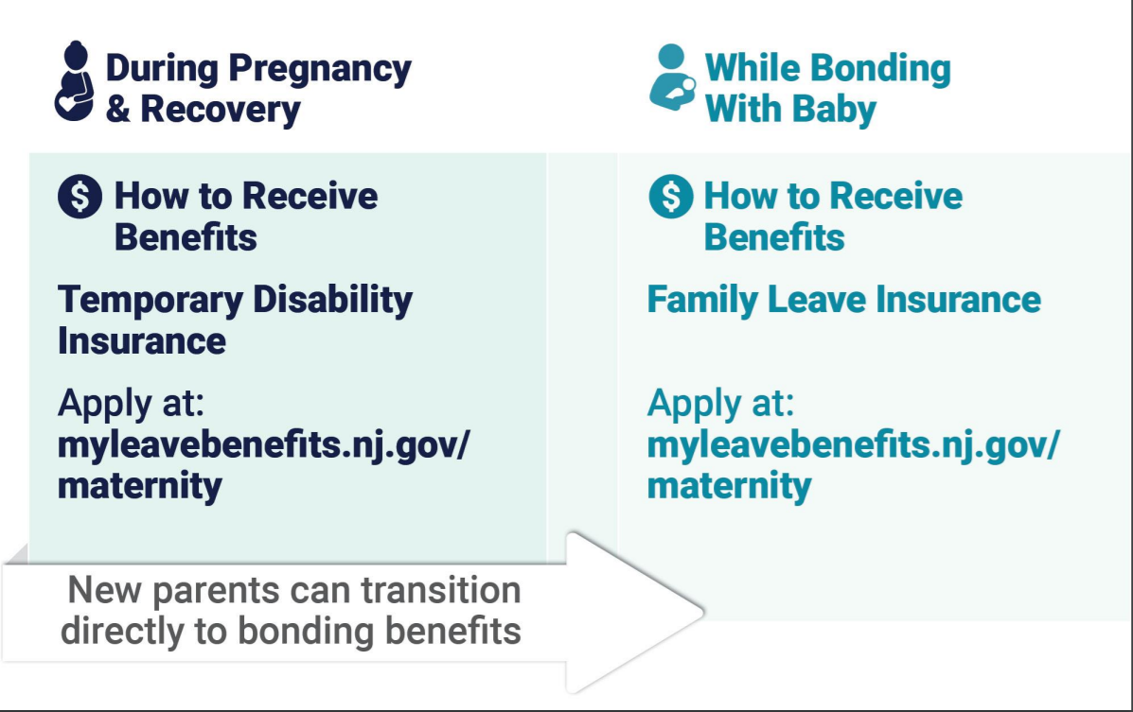
PAID AND JOB-PROTECTED LEAVE DURING PREGNANCY AND RECOVERY
Notes:
Rebecca

Slide 32
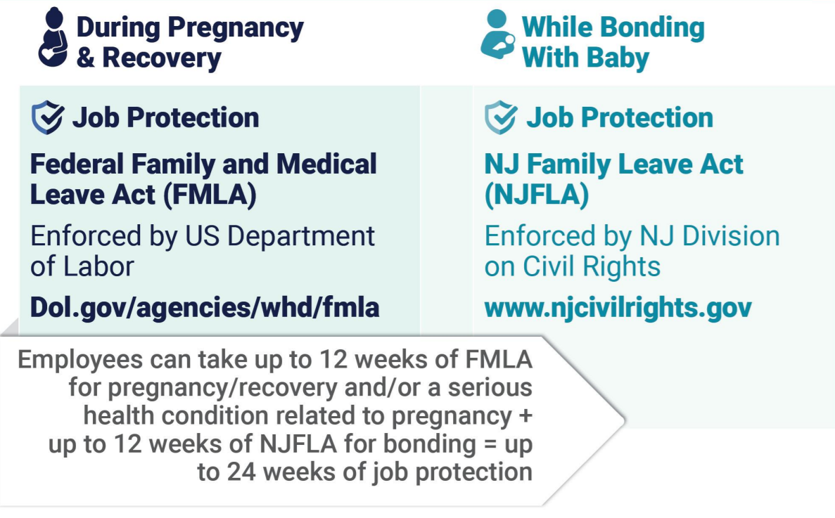
PAID AND JOB-PROTECTED LEAVE DURING PREGNANCY AND RECOVERY
Notes:
Rebecca

Slide 33
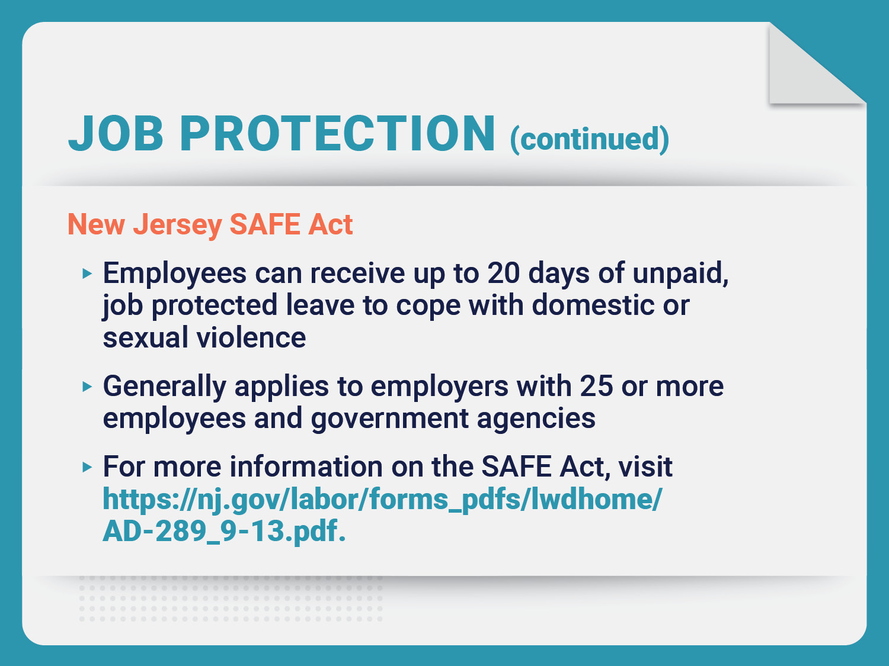
Notes:
Rebecca

Slide 34
RETALIATION
It is unlawful for an employer to retaliate against you for taking or seeking to take their Temporary Disability or Family Leave benefits. Retaliation includes, but is not limited to:
Being fired
Reducing your salary
Increasing oversight on your job duties
Changing your workplace responsibilities
Excluding you from meetings
If retaliation occurs, you have the right to take private legal action.
Notes:
Rebecca

Slide 35
FOR MORE INFO OR HELP WITH A TEMPORARY DISABILITY OR FAMILY LEAVE INSURANCE CLAIM:
Customer service: 609-292-7060
Website: myleavebenefits.nj.gov / click “Need Help?”
Mailing address:
NJ Department of Labor & Workforce Development
Division of Temporary Disability & Family Leave Insurance
PO Box 387
Trenton, NJ 08625-0387
Fax: 609-984-4138
Notes:
Rebecca

